Slide 1


Portfolio introduciton
Miko Plaster, Underwater Magnets, Kits, Sea Chest Covers
Miko Marine AS
info@mikomarine.com
www.mikomarine.com
[Premise]
By: [Name]
[Date]

Slide 2
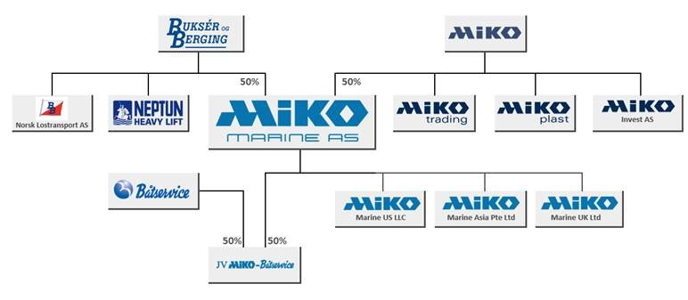
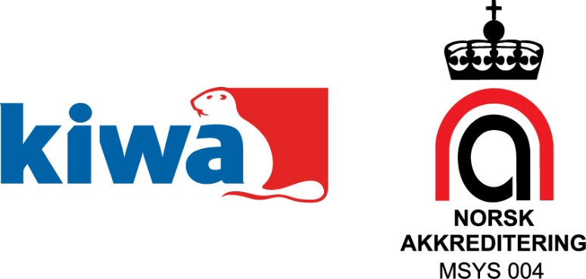
About Miko Marine
Established 1996
Focus on safeguarding life, environment and property in the maritime industry
Owned by Buksér og Berging AS and Miko AS
ISO 9001:2015 certified

Slide 3
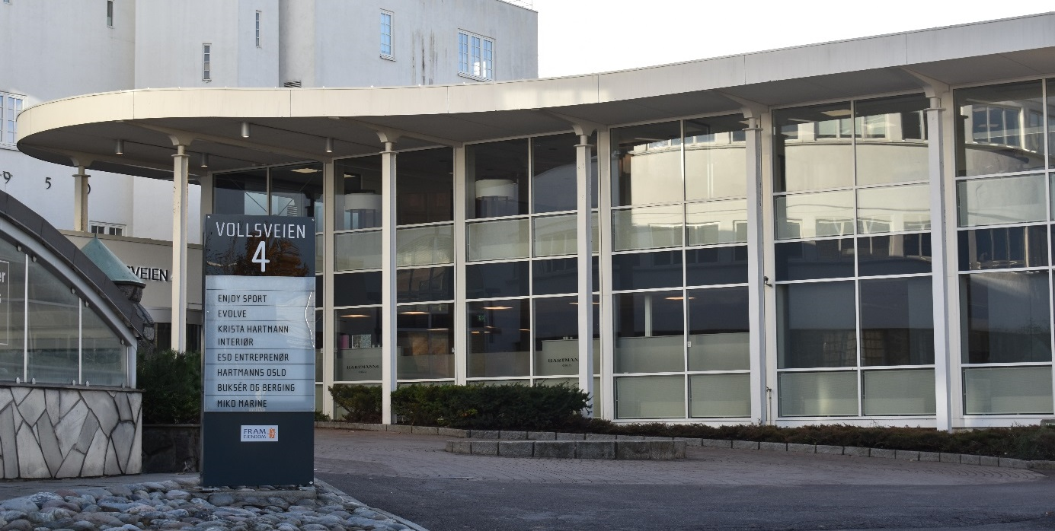
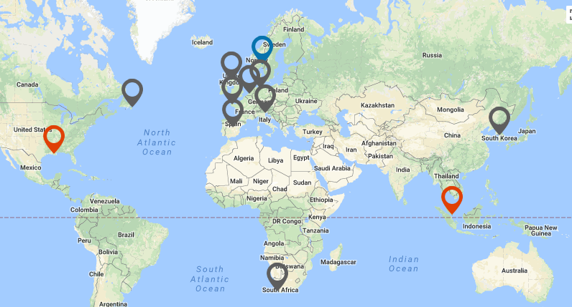
About Miko Marine
Headquarters in Oslo, Norway
Production by long-lasting partners in Norway
Subsidiaries in USA and Singapore
Sales distributors worldwide

Slide 4
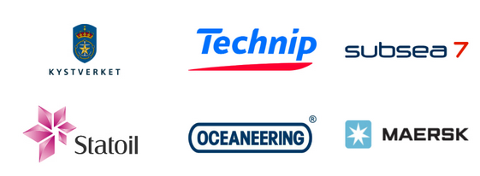


About Miko Marine
In-house competence
  Product development & design
  CAD, FEM
  Naval architecture
  Marine operations
  Diving
  ROV
Customers include government organisations, shipping companies, oil companies, diving companies, etc
Solid finance

Slide 5
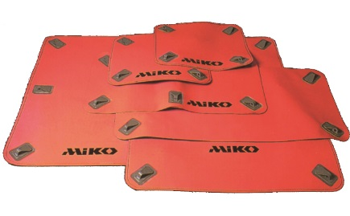
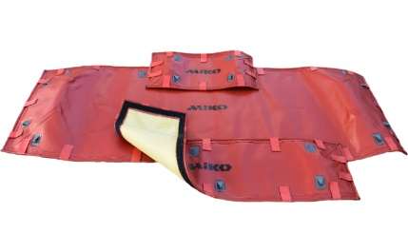
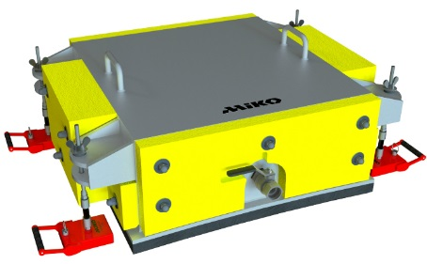
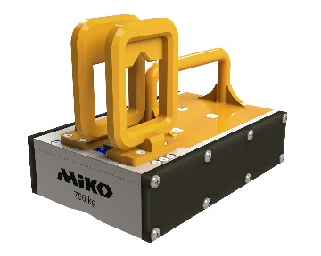
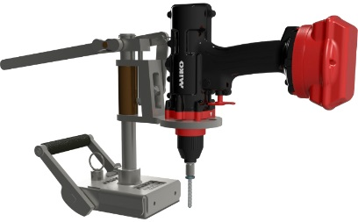
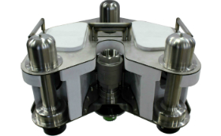
Product segments
 | Salvage & oil spill prevention | Underwater blanking | Subsea & ROV
Magnetic Miko Plaster | X | X
FlexiShape Miko Plaster | X
Sea chest covers |  | X | X
Underwater magnets | X | X | X
Underwater fasteners | X
Moskito | X |  | X

Slide 6
Magnetic Miko Plaster
For sealing off sea chests, water inlets and outlets on floating structures
Used as a cost-saving alternative to drydocking
Can also be used for temporary repair of cracks and punctures in hull

Slide 7
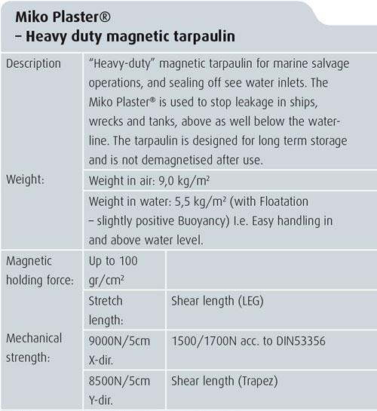
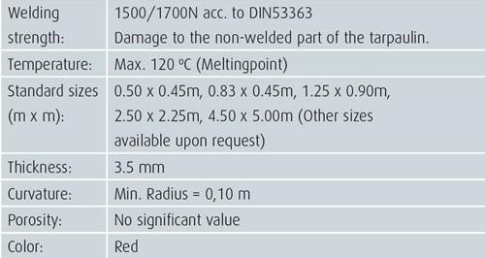
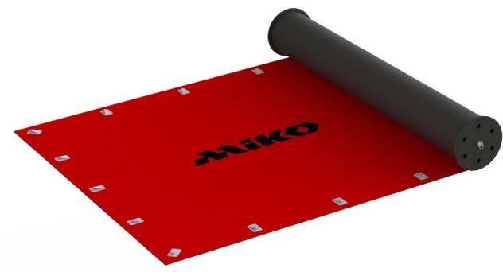
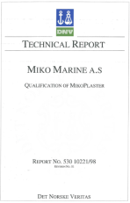
Magnetic Miko Plaster

Slide 8
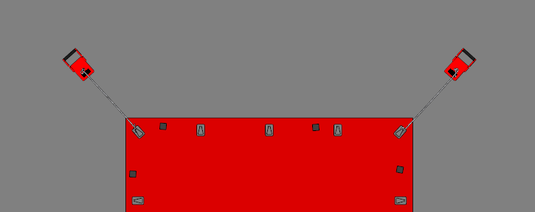
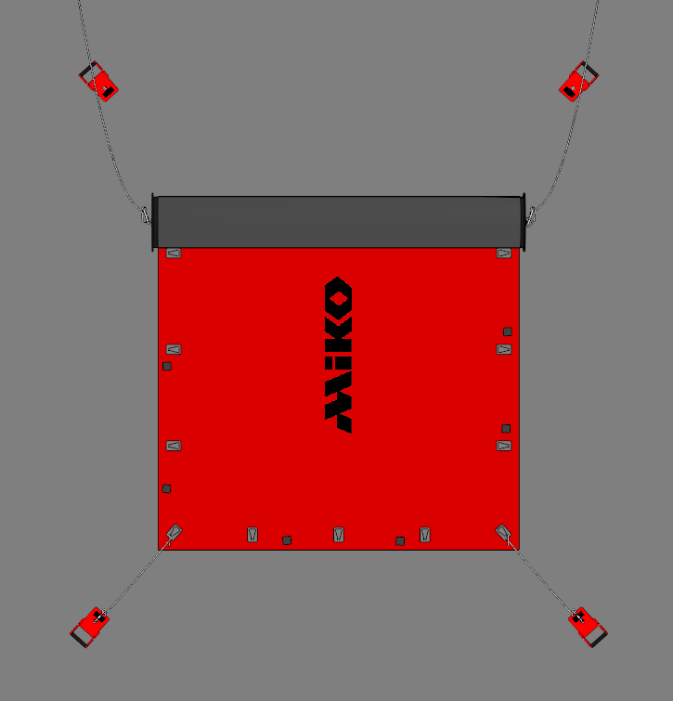
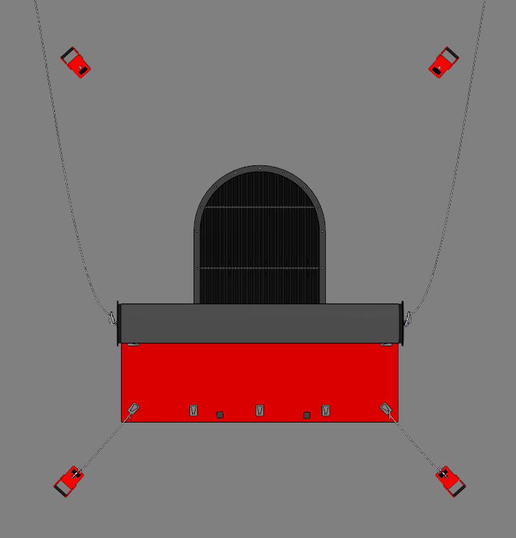
Magnetic Miko Plaster
Simple installation using installation drum, anchor magnets and handling ropes

Slide 9
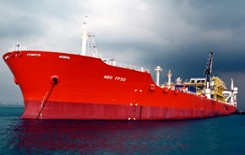
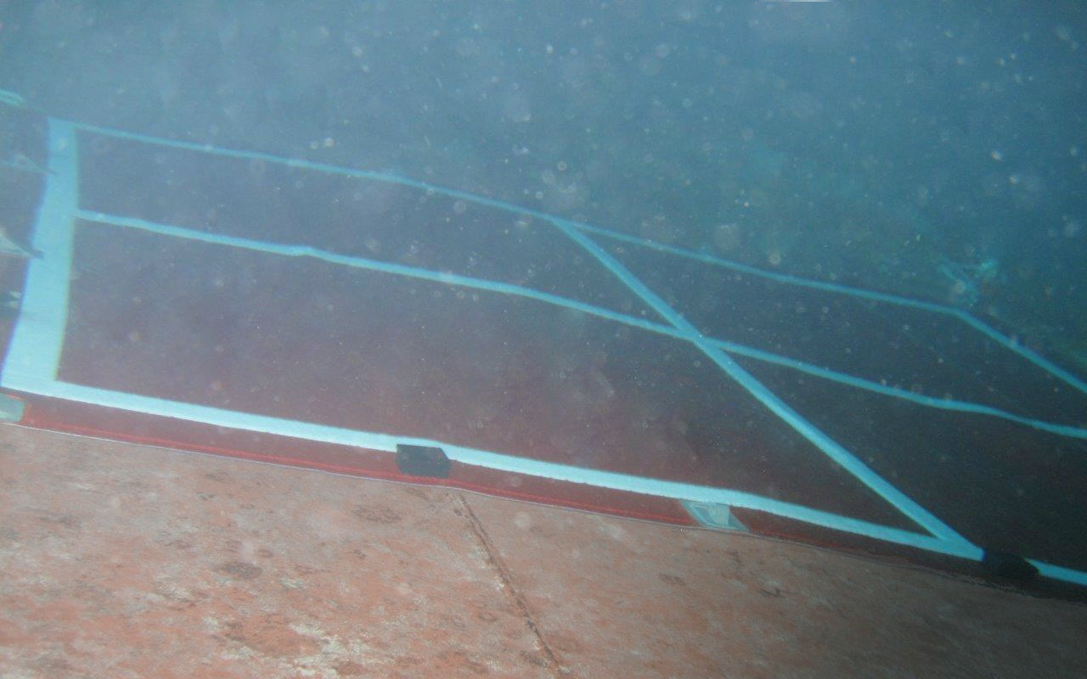
Magnetic Miko Plaster – BW Offshore
Cracks in hull plating at engine room on FPSO “Abo”
Miko Plaster was applied to stop the leak

Slide 10
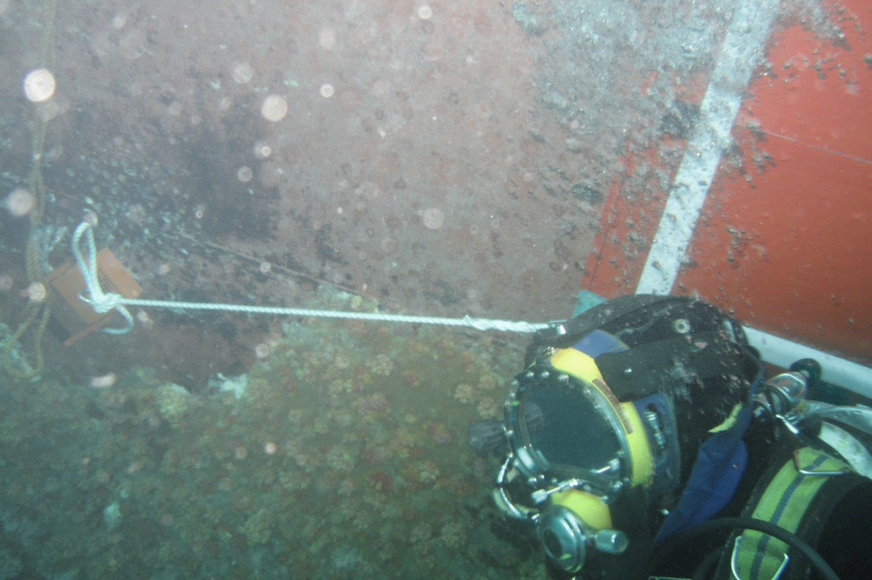
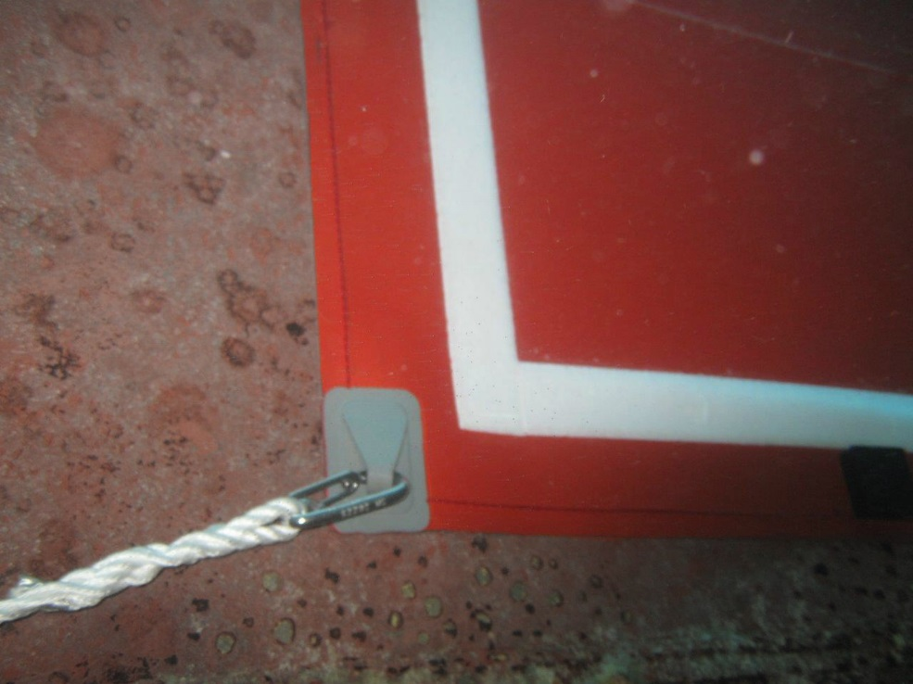
Magnetic Miko Plaster – BW Offshore
With Miko Plaster secured on the outside, repair welding was carried out from inside

Slide 11
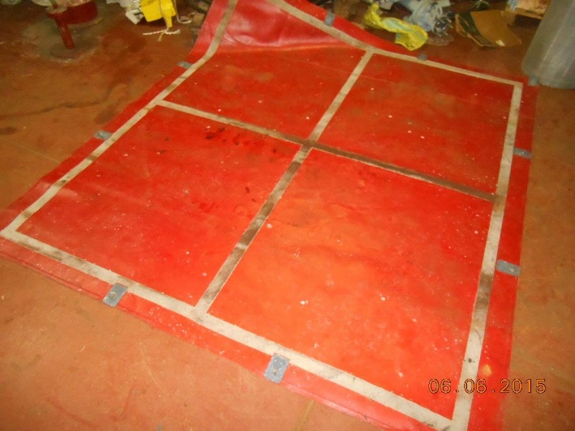
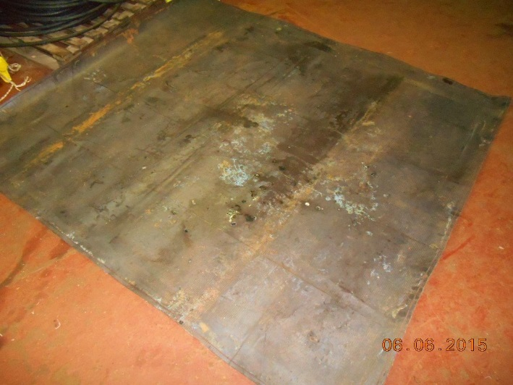
Magnetic Miko Plaster – BW Offshore
After 6 months in place and while withstanding extensive welding, the Miko Plasters were removed
"There are damages to the inner layer, the outer layer is however in perfect condition. Bear in mind that the plaster have been utilized for approx. 6 months, with extensive welding carried out on engine room side. My opinion is that the plaster did its job!“ - Knut Trygve Eide, BW Offshore

Slide 12
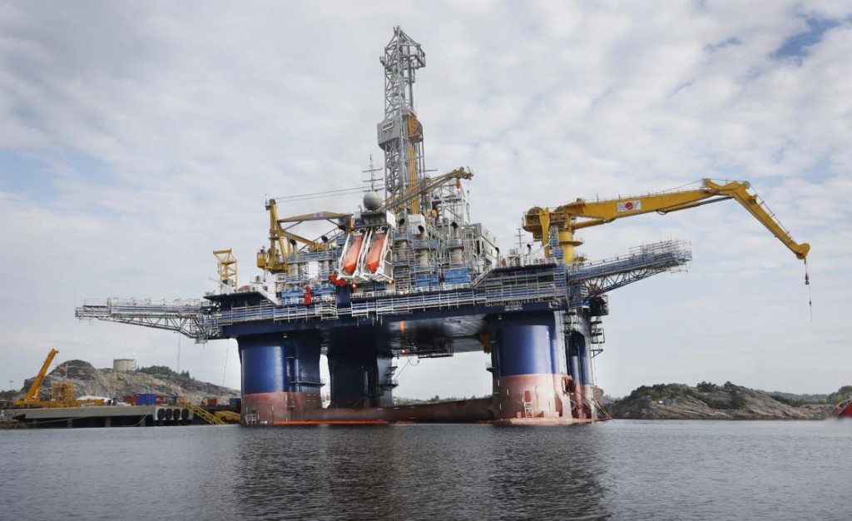
Magnetic Miko Plaster - Odfjell
Semi-submersible Island Innovator suffered uncontrolled leakage due to a failing pipe plug
63 crew members evacuated
Miko Plaster available nearby
applied temporarily to stop
the leak

Slide 13
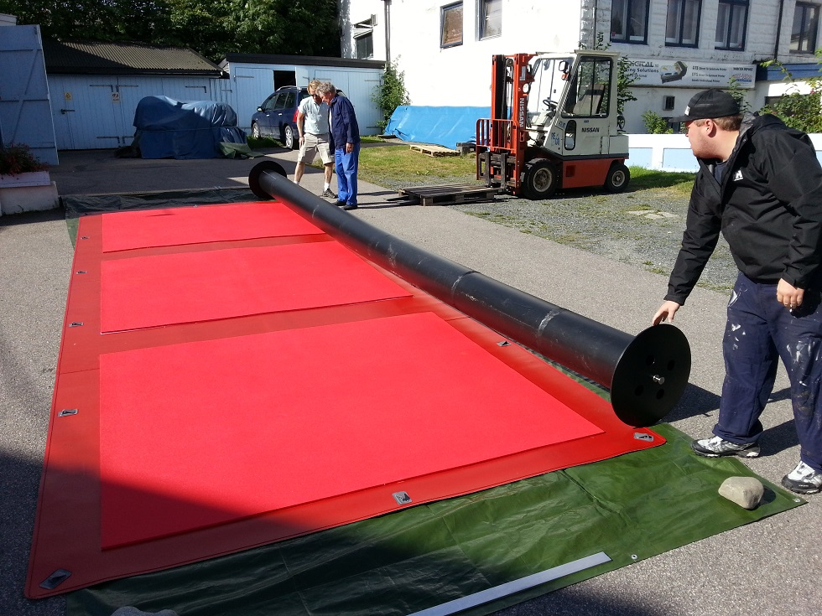
Magnetic Miko Plaster - Odfjell
Contracted by Otech, Miko Marine delivered a custom-made Miko Plaster to blank off four adjacent sea chest apertures, along with a specially
adapted pipe plug

Slide 14
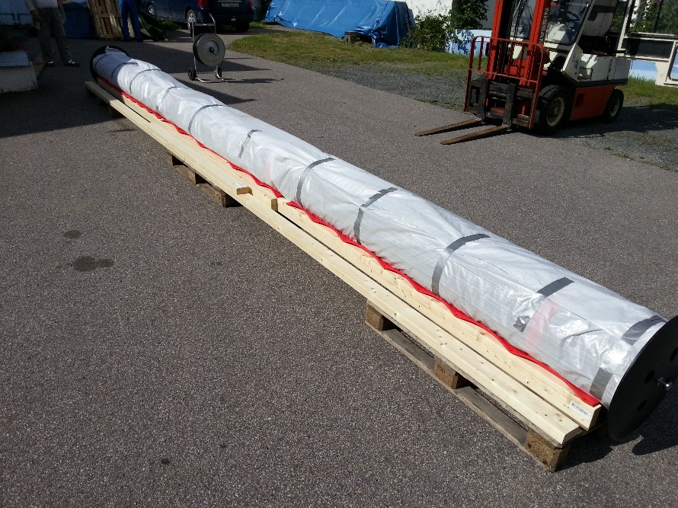
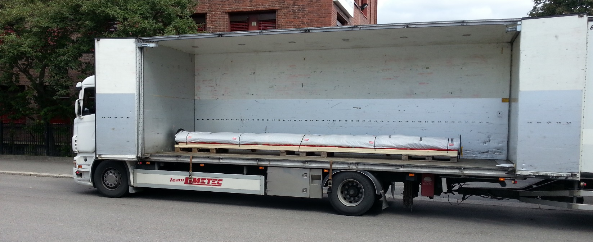
Magnetic Miko Plaster - Odfjell
The double independent barriers allowed Odfjell to finish the work on the rig in a safe and controlled manner

Slide 15

FlexiShape Miko Plaster
For groundings and collisions
Flexible patch for uneven surfaces
Aramide-reinforced inner layer

Slide 16
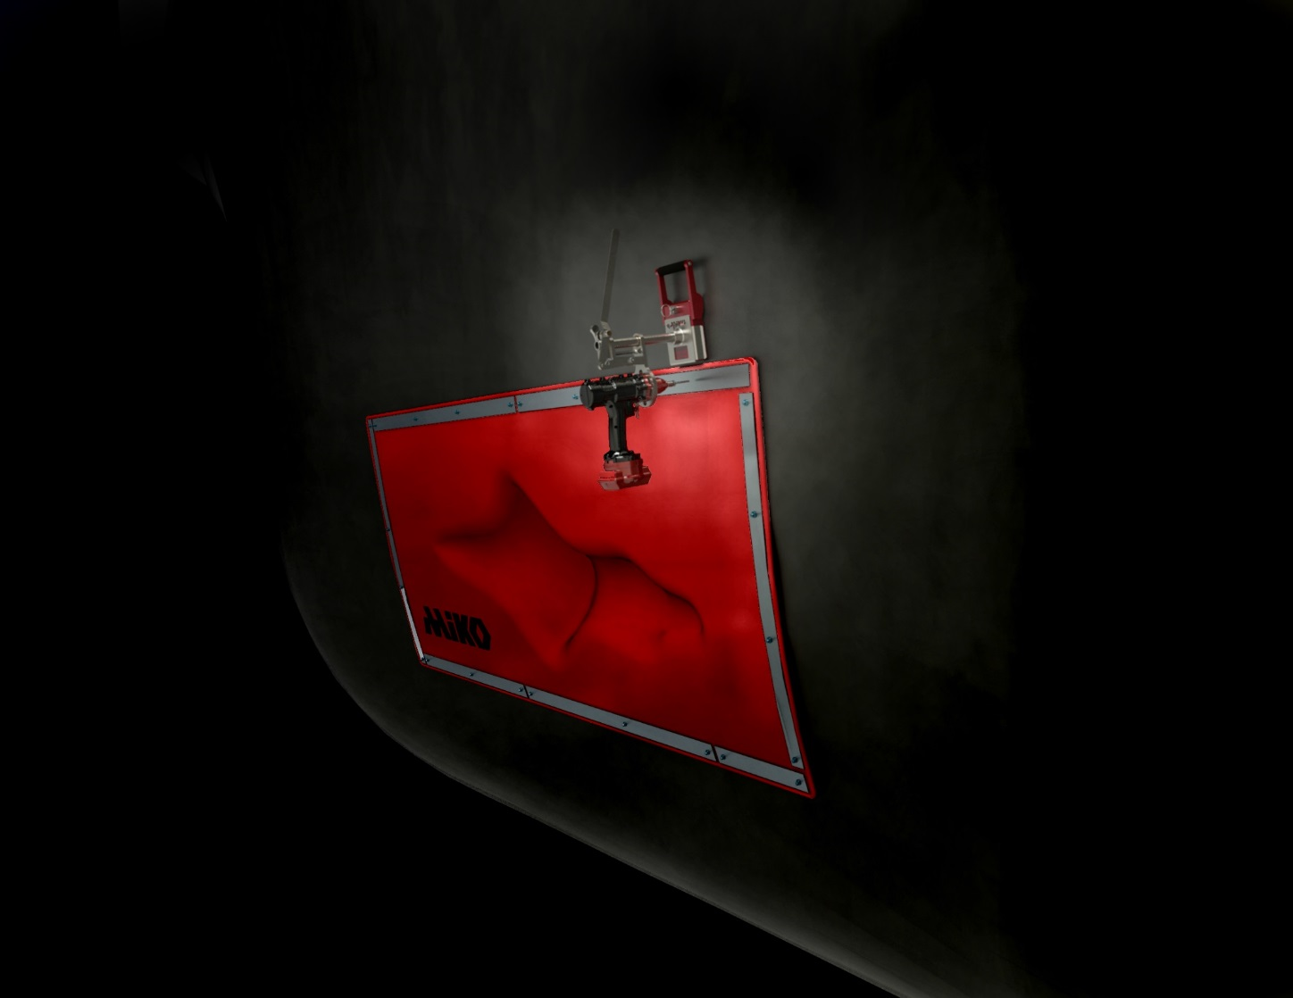
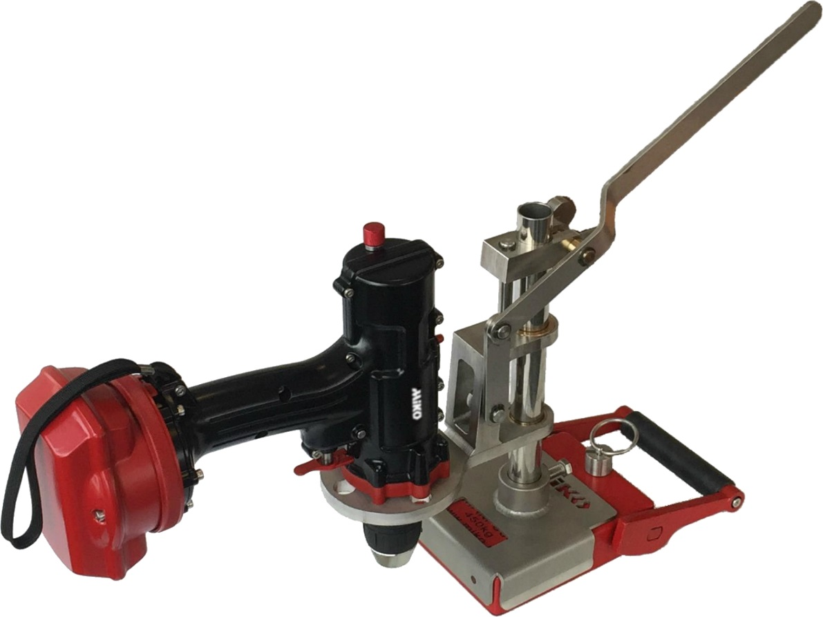
FlexiShape Miko Plaster
Secured in place using the Miko Fix fastening system

Slide 17
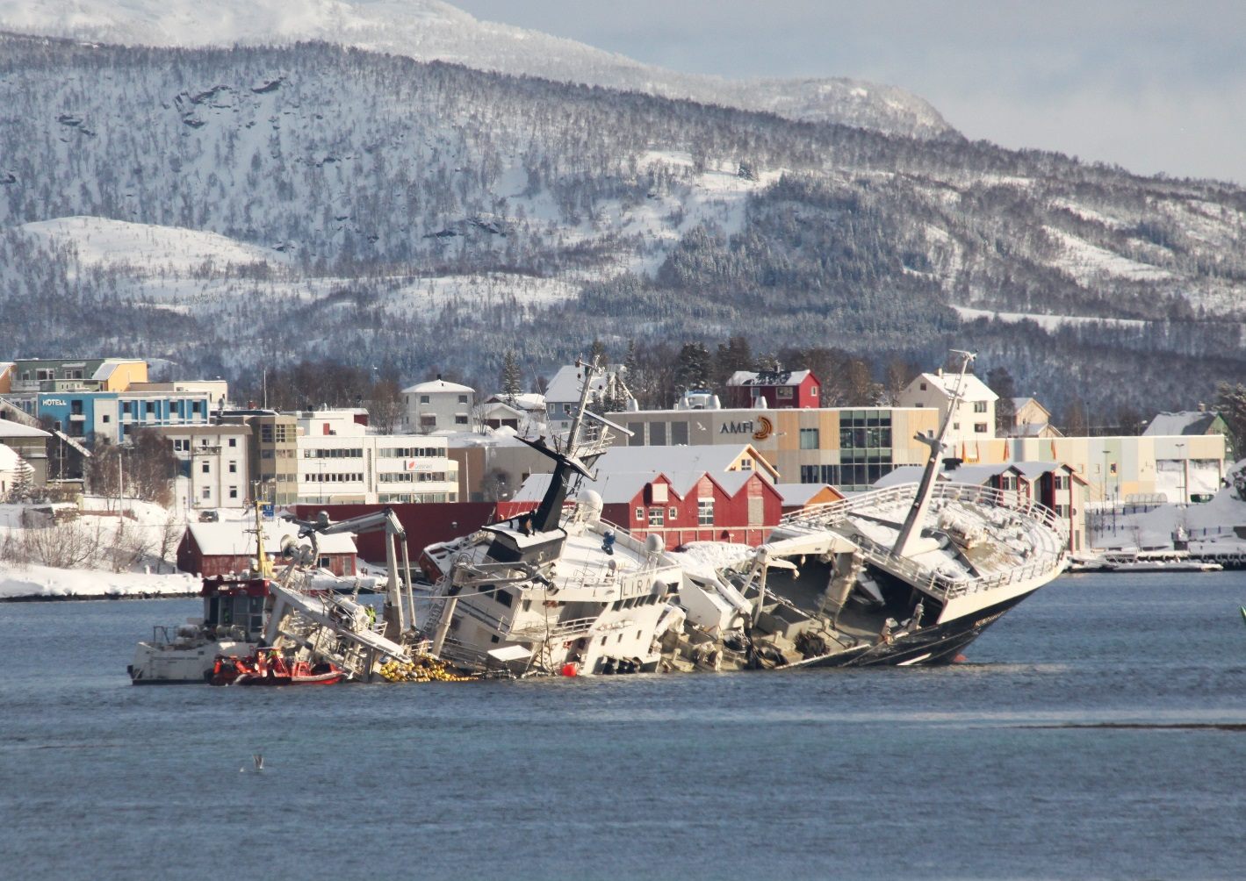
FlexiShape Miko Plaster - Hundvåkøy
Collision caused 5x1m rip in engine room below water line
Captain decided to ground vessel to prevent total loss
FlexiShape Miko Plaster deployed immediately to repair and refloat

Slide 18
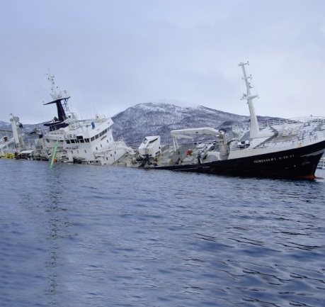
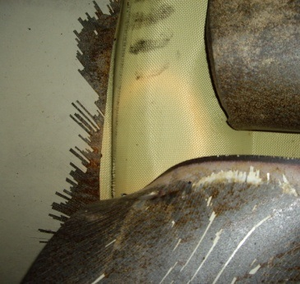
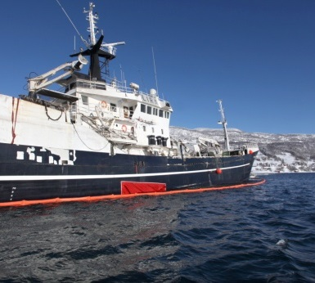
FlexiShape Miko Plaster - Hundvåkøy
Vessel refloated
21:15 – Vessel patched and ready to refloat
15:30 – Miko personnel arrives on site
12:00 – Coast guard arrives with Miko Salvage Kit
Vessel towed to quay and secured
07:55 – Vessel grounded to avoid total loss
07:50 – Collision rips a 5.5 x 1 meter hole in engine room below the water line

Slide 19
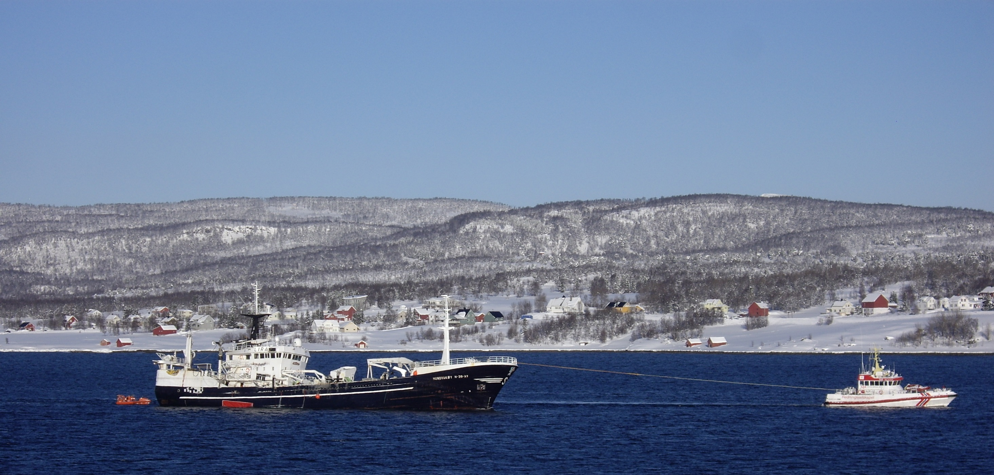
FlexiShape Miko Plaster - Hundvåkøy
Salvage kits now stored by Norwegian Coastal Administration along the coast of Norway and used regularly to prevent oil spill

Slide 20
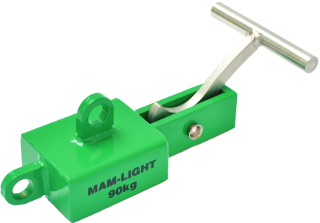
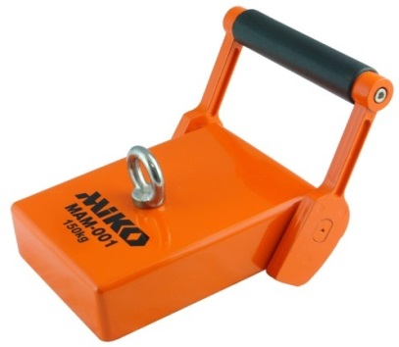
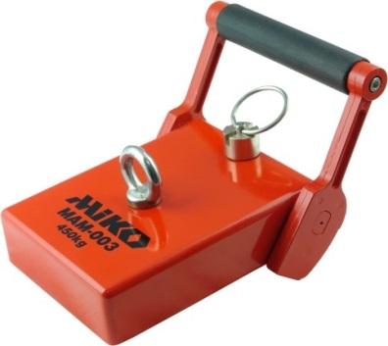
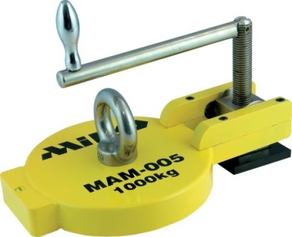
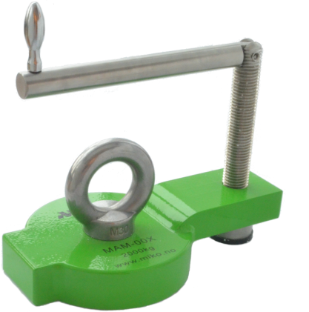
Underwater Magnets
Ranging from 90 to 2 000 kg
Typical applications:
  Anchor points for divers
  Installing Miko Plaster
  Improved watertight seal
  Securing oil booms
  Securing mooring lines
  Securing fenders
MAM-Light
MAM-001
MAM-003
MAM-005
MAM-00X

Slide 21

ROV Magnet
ROV interface
Switchable magnet
No electric or hydraulic components
Holding force 750 kg

Slide 22

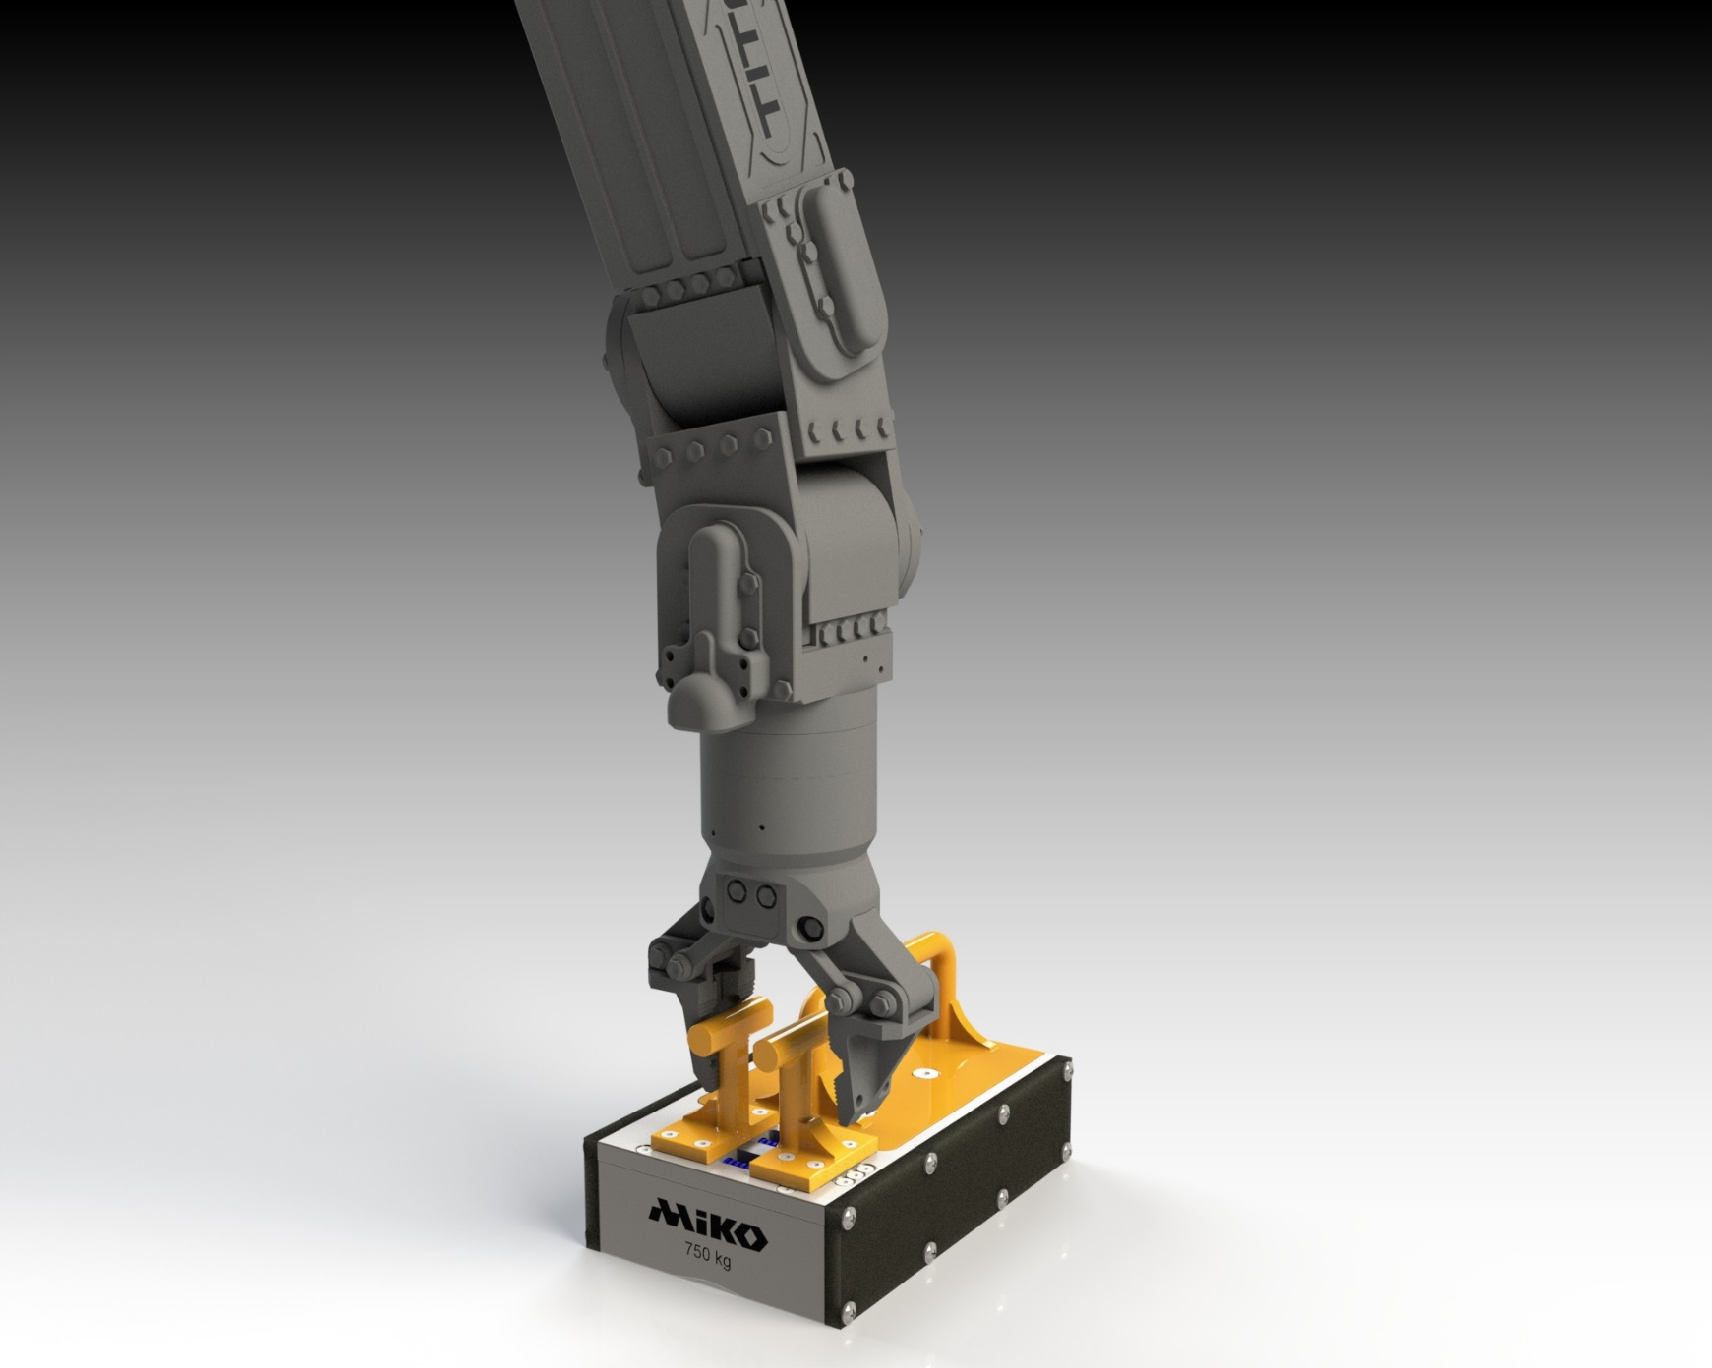
ROV Magnet
Grab handles – magnet switched off
Release handles – magnet switched on

Slide 23
Miko Plaster Kits
 | Miko Anchor Magnets | Underwater Fastener | Magnetic Miko Plaster | FlexiShape Miko Plaster
Tank Sealer Kit | X |  | X
Emergency Response Bag | X |  | X
Tanker Kit | X |  | X
Salvage Kit | X | X |  | X
Yacht Salvage Kit | X | X | X | X
Custom kit | As per request | As per request | As per request | As per request

Slide 24
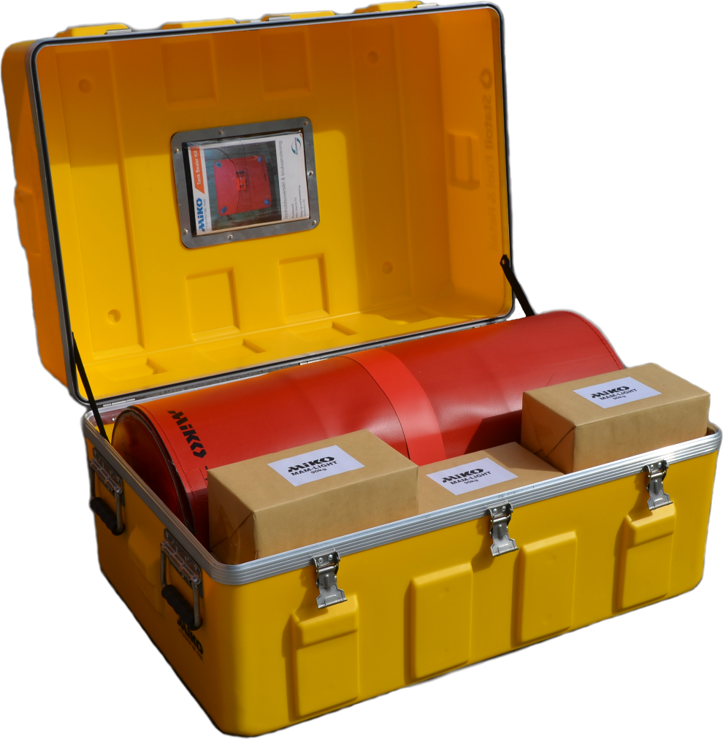
Tank Sealer Kit
First barrier against leakages on storage tanks
Neoprene Miko Plaster® and strong magnets combined
Total weight: 56 kg
Quantity | Item
1 | Neoprene Miko Plaster® 750 x 750 mm (with 300 x 300 mm neoprene sheet)
1 | Neoprene Miko Plaster® 750 x 1 050 mm (with 300 x 600 mm neoprene sheet)
2 | MAM-003 Miko Anchor Magnet
4 | MAM-Light Miko Anchor Magnet
1 | IP54-classed storage- and transportation box

Slide 25
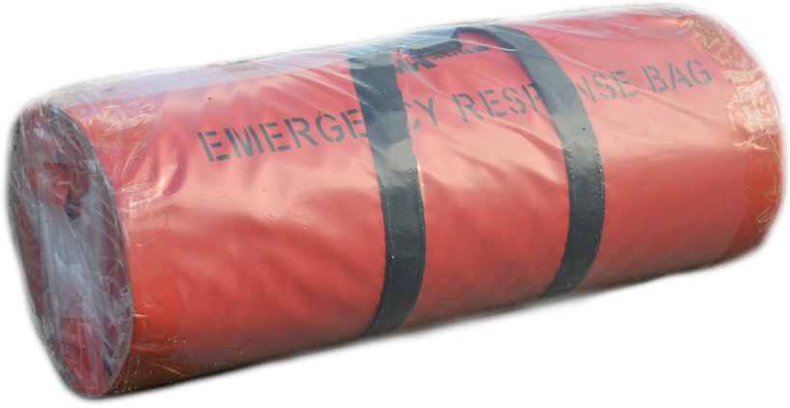
Emergency Response Bag
Small cracks and openings
Total weight: 40 kg
Quantity | Item
1 | Magnetic Miko Plaster ® 450 mm x 500 mm
1 | Magnetic Miko Plaster ® 450 mm x 833 mm
1 | Magnetic Miko Plaster ® 900 mm x 1 250 mm
1 | MAM-001 Miko Anchor Magnet
10 | MPM-002 Miko Permanent Magnets
1 | MHT-002 Handling Tool for Permanent Magnets
4 | MHT-001 Handling Ropes with Pelican Hook

Slide 26
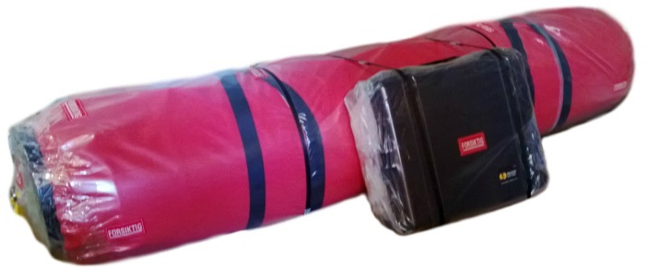
Tanker Kit
Larger openings and sea chests
Total weight: 220 kg
Quantity | Item
2 | Magnetic Miko Plaster® 900 mm x 1 250 mm
2 | Magnetic Miko Plaster® 2 250 mm x 2 500 mm (with temporary buoyancy sheeting)
1 | Installation Drum, length 2 300 mm
4 | MAM-001 Miko Anchor Magnet
10 | MPM-002 Miko Permanent Magnets
2 | MHT-002 Handling Tool for Permanent Magnets
4 | MHT-001 Handling Ropes with Pelican Hook

Slide 27
Salvage Kit
Groundings and collisions
The most comprehensive kit for large damages
Total weight: 550 kg
Quantity | Item
1 | FlexiShape Miko Plaster® 500 mm x 1 000 mm
1 | FlexiShape Miko Plaster® 500 mm x 2 000 mm
1 | FlexiShape Miko Plaster® 1 000 mm x 3 000 mm
1 | FlexiShape Miko Plaster® 2 000 mm x 6 000 mm
1 | FlexiShape Miko Plaster® 6 000 mm x 8 000 mm
60 m | Aluminium Flat Bars (50 pcs á 1200 mm)
20 | MAM-001 Miko Anchor Magnet
50 | MPM-002 Miko Permanent Magnets
2 | MHT-002 Handling Tool for Miko Permanent Magnets
10 | MHT-001 Handling Ropes with Pelican Hook
4 | Miko Fix

Slide 28
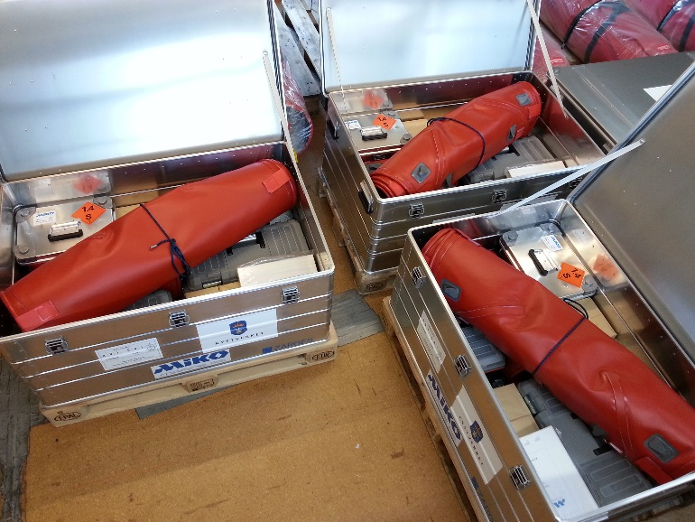
Salvage Kit GRP/Aluminium
Emergency repair of non-ferromagnetic hulls
Delivered to Spanish Navy in 2007
Quantity | Item
1 | FlexiShape Miko Plaster® 500 mm x 1 000 mm
1 | FlexiShape Miko Plaster® 500 mm x 2 000 mm
1 | FlexiShape Miko Plaster® 1 000 mm x 3 000 mm
1 | FlexiShape Miko Plaster® 2 000 mm x 6 000 mm
32 m | Aluminium Flat Bars (27 pcs á 1200 mm)
10 | MHT-001 Handling Ropes with Pelican Hook
2 | Underwater Fastener HD211 incl barrels & drive pins

Slide 29
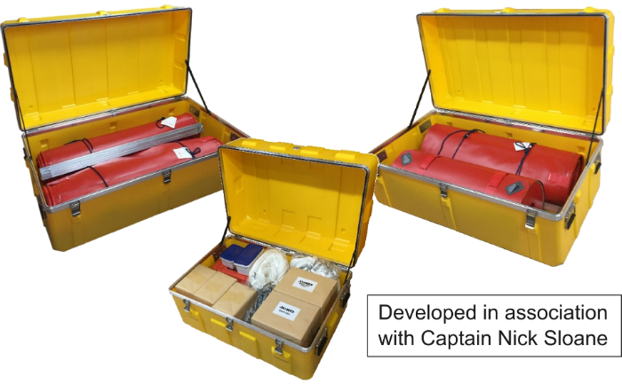
Yacht Salvage Kit
Quantity | Item
1 | FlexiShape Miko Plaster® 1 000 mm x 3 000 mm
1 | FlexiShape Miko Plaster® 2 000 mm x 2 000 mm
1 | Magnetic Miko Plaster® 900 mm x 1 250 mm
30 m | Aluminium Flat Bars (25 pcs á 1200 mm)
4 | MAM-001 Miko Anchor Magnet
10 | MPM-002 Miko Permanent Magnets
2 | MHT-002 Handling Tool for Miko Permanent Magnets
8 | MHT-001 Handling Ropes with Pelican Hook
1 | Complete Miko Fix
200 | Extra Miko Bolt 16mm/22mm (100 pcs each)
3 | IP54-classed storage- and transportation box
Hybrid Magnetic/FlexiShape Miko Plaster Kit
Total weight: 192 kg

Slide 30
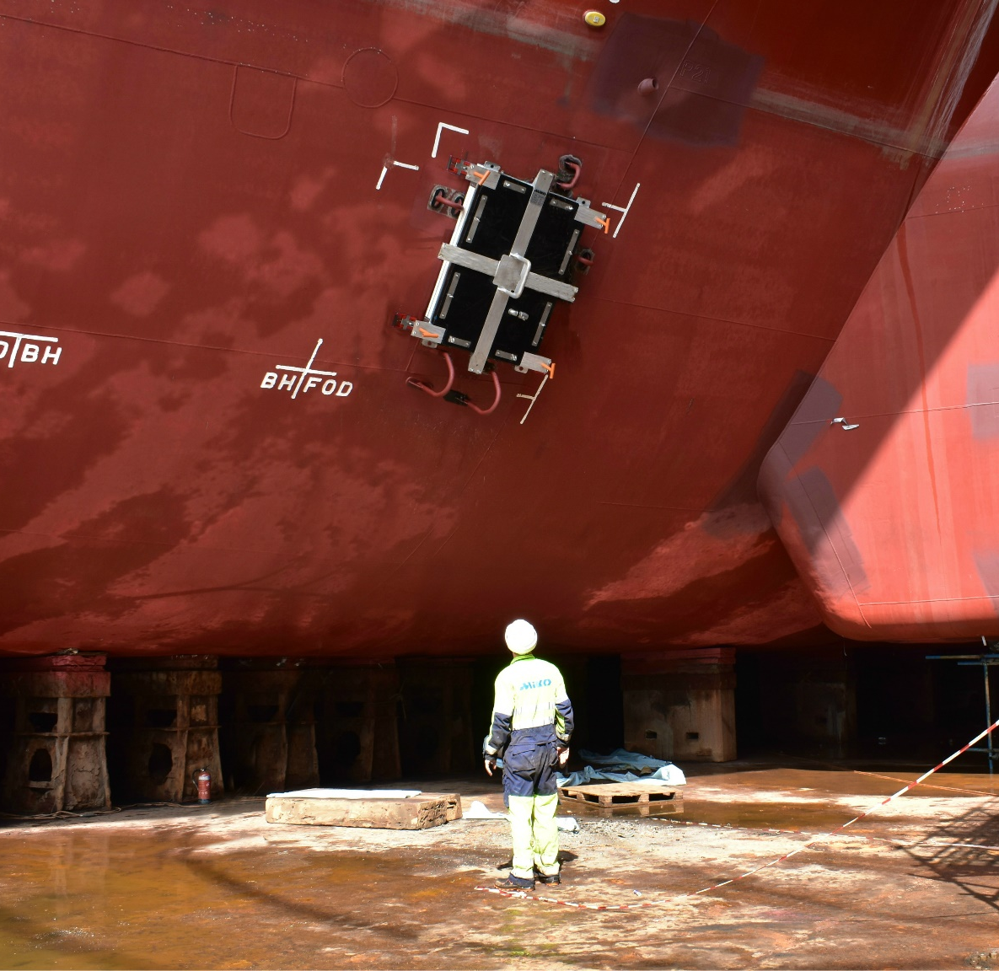
Sea chest covers
Aluminium or steel constructions
Neutrally buoyant
Clamped to hull with magnets or by locking onto sea chest grid
Design factors:
  Vessel draft
  Hull curvature
  Installed by divers or ROV
  Single or double barriers

Slide 31
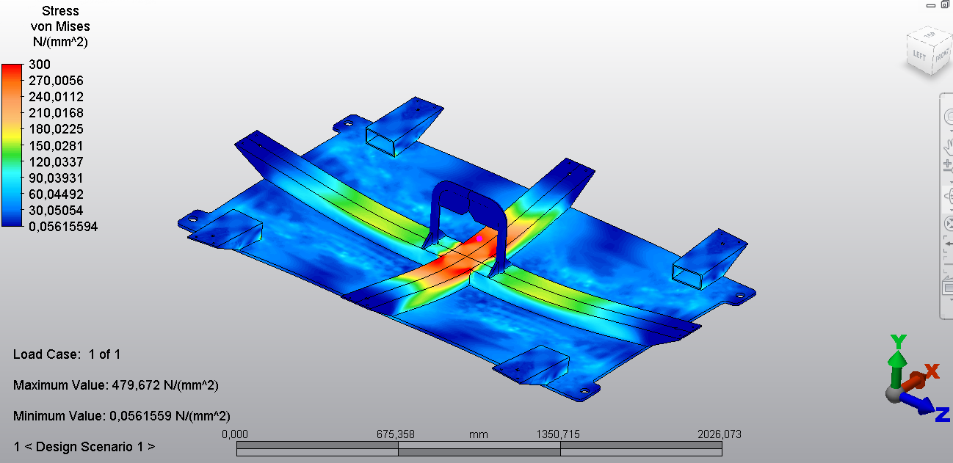
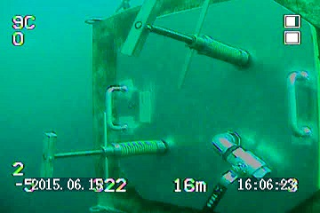
Sea chest covers
Structural integrity verified by
  FEM analysis
  Pressure test
  3rd party, e.g. DNV GL

Slide 32
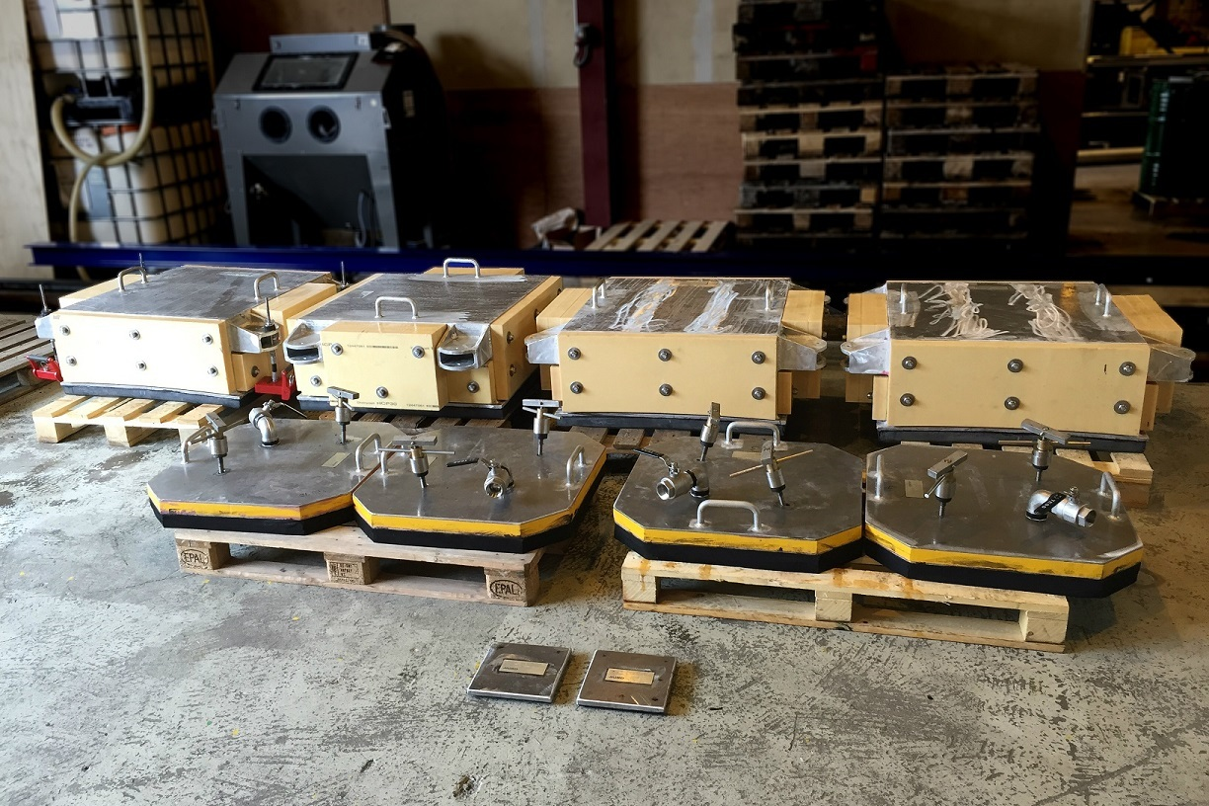
Sea chest covers - Odfjell
Double independent barriers for
  4 sea chests
  10 pipe inlets
For use by divers on the “Deep Sea Stavanger” semisubmersible

Slide 33

Sea chest covers - Odfjell
Inner barrier secured to sea chest grid
Outer barrier clamped using 4 pcs MAM-003 Miko Anchor Magnets
Pipes plugged and blanked using low-profile plugs and Magnetic Miko Plaster

Slide 34

Sea chest covers - Teekay
Four sea chest covers for the Gina Grog FSO
Installed by ROV
Conversion in Sembawang shipyard, Singapore

Slide 35


Sea chest covers - Teekay
Complicated double curvature
3D laser scanning of hull performed in drydock

Slide 36

Sea chest covers - Teekay
Installation by ROV

